Slide 1

Wind Power Predictive Modeling
Final Project for Ironhack Bootcamp
- Nipun Bhushan

Slide 2
GoaL

Slide 3




Weather conditions
Power Production
Wind Farm
Improve the planning and management of the integration of renewable energy into the grid.
Predict the excess energy production and then optimize the energy storage system to store that excess energy for future use, and vice versa.

Slide 4
Data Insights

Slide 5
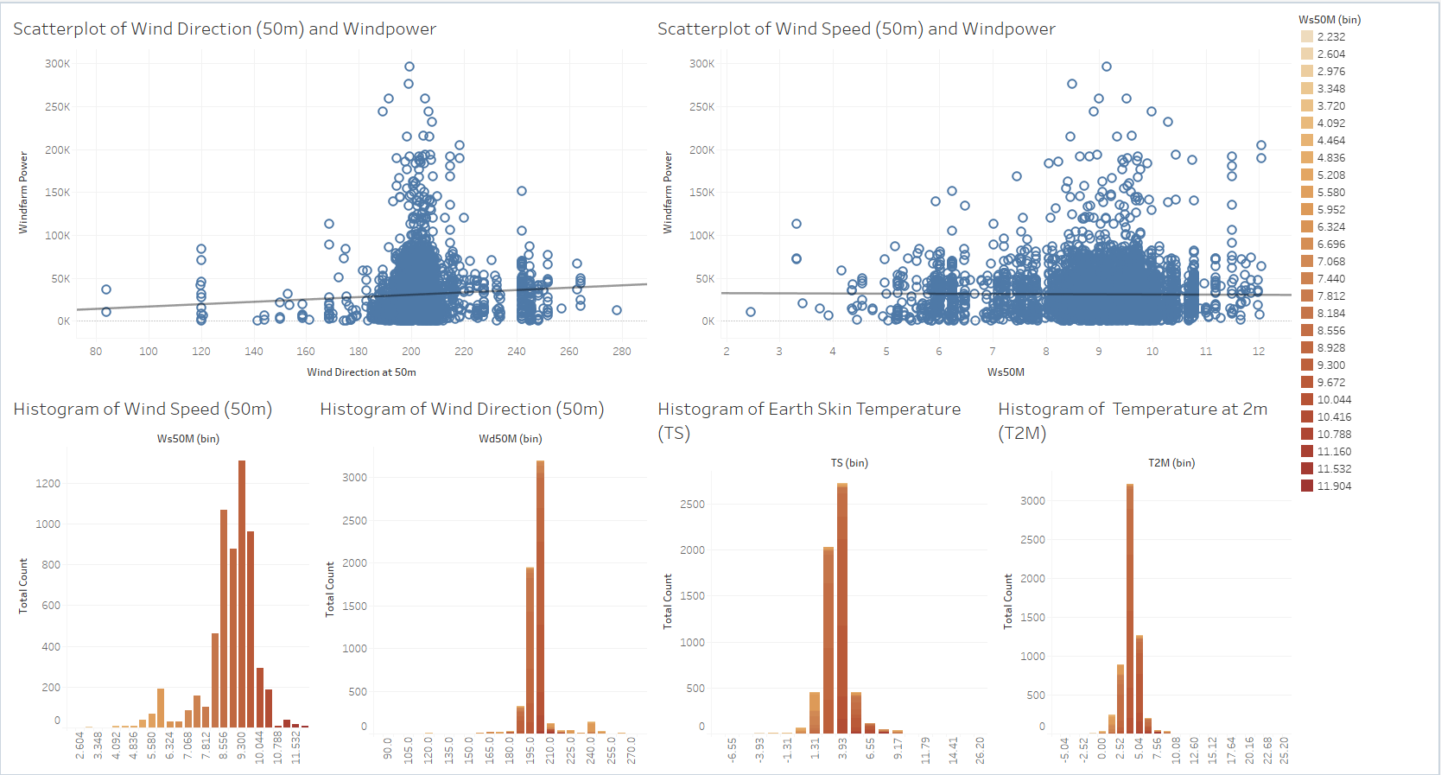
Scraped Wind Farm Data Statistics

Slide 6
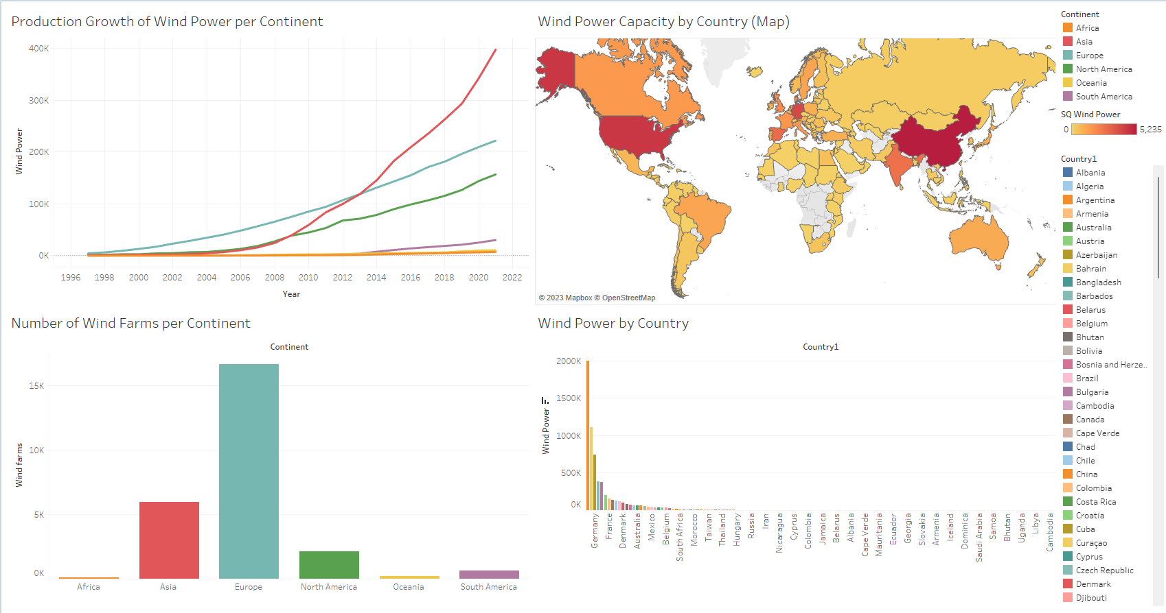
Wind Farm by Country Statistics

Slide 7




Where does the model fits in?
Power Output
Forecast
Historical Weather Data
Predictive
Modelling

Slide 8

What can we achieve?
Fluctuations in
Weather Data (wind forecast data)
Predictive
Model
Power Output
Forecast

Slide 9
The Approach (Taken)

Slide 10


Web API
Web Scraping
Selenium
Web Scraping
X | y

Slide 11
- As, only last month’s power generation data was available for each windfarm. - This was used to build the model with input features as monthly averaged weather data. - The data set was compiled as one row for each windfarm with corresponding power output. - Random Forest Regressor was used to build the model.
Historical Monthly Data
for each wind farm lacking
Exhaustive weather features
lacking

Slide 12
The Approach (Ideal)
How to scale and improve the model
WARNING: Seeing multiple icons on next slide might make you overwhelmed.

Slide 13


Historical Weather Data for each Windfarm
Predictive
Modelling for each windfarm
Bagging
And creating a Random Forest Regressor

Slide 14

धन्यवाद!
¡Gracias!
Thank you!
*A pinwheel in my backyard

